Slide 1


Supplier Audit Results Prediction
Data Science Internship Case Study
Juan Betancourt
October 2023

Slide 2
Contents
Introduction
Data Exploration
Data Preprocessing Data and Feature Engineering
Model Selection and Predictions
Business Recomendations
Model Maintenance
Further development

Slide 3
Introduction
Require effective management
Audits to ensure the reliability
Suppliers

Slide 4

Introduction
Suppliers

Slide 5
Introduction
Derivatives

Slide 6







Introduction
Qualifications
$$Stages$$
Supplier is qualified
T3
T2
Supplier receives a warning
T1
Audit Result
Supplier is disqualified
Qualification of the latest audit stage
$$t$$
$$1$$
$$2$$
$$3$$
$$4$$
$$5$$

Slide 7
Data Exploration
Two datasets
Audit History
Supplier Performance
- Month
- Derivative Region
- Production Line
- Qualification for all three stages
- Result
- Wrong deliveries in the last 3, 6 and 12 months
- Backlogs in the last 3, 6 and 12 months
- LPKM score (5-star rating)
- Binary indicator of past bad performance
7690 observations
Interval of 9 months
818 suppliers, 75 derivatives, 4 production lines and 6 regions
Suppliers have from 1 up to 21 entries
5823 observations, one per supplier
A total of 332 bad performance indications

Slide 8
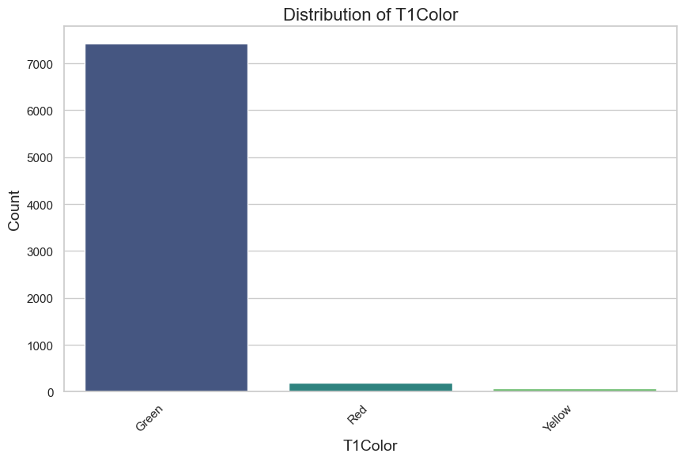
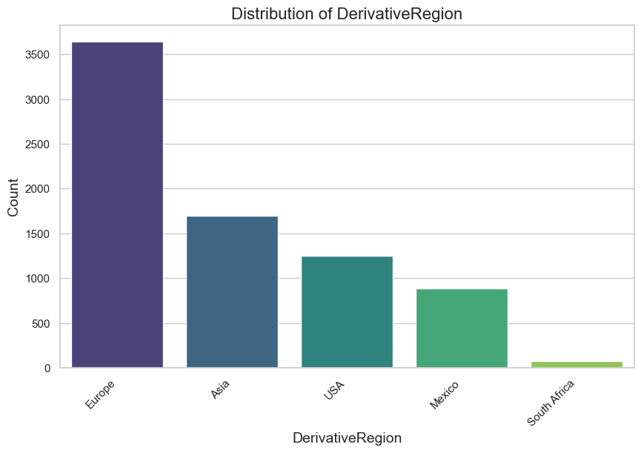
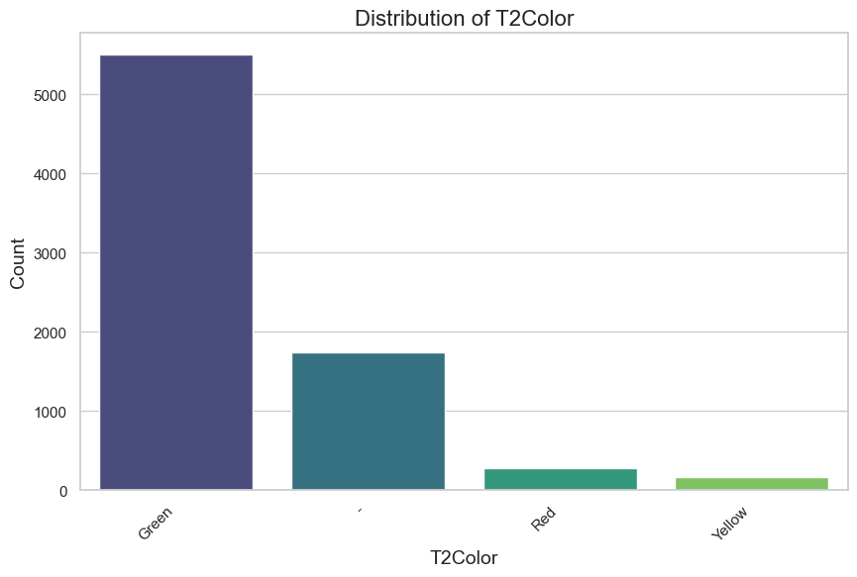
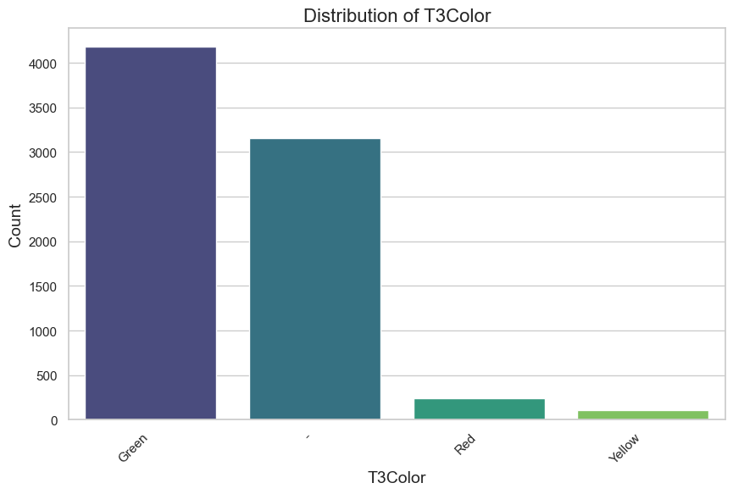
Data Exploration
T1
Audit History – Distributions
Region
Audit Results
T2
T3

Slide 9
Data Exploration
Audit History – Missing values

Slide 10
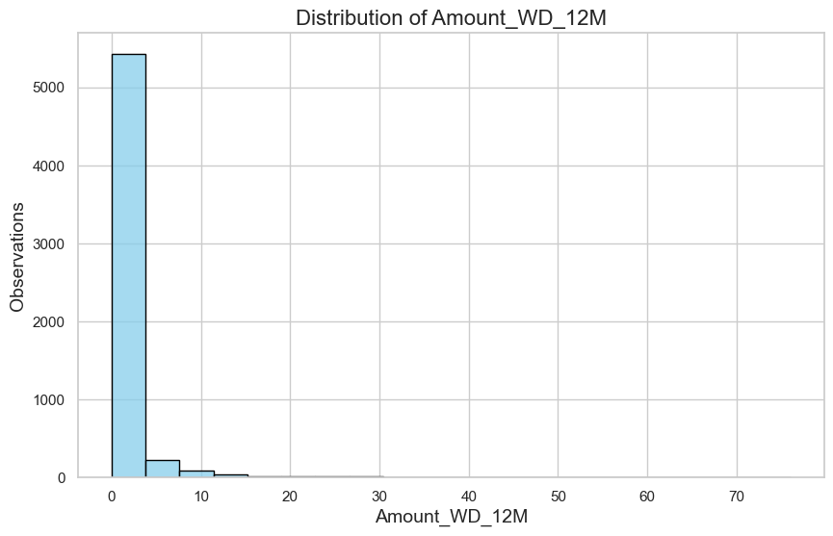
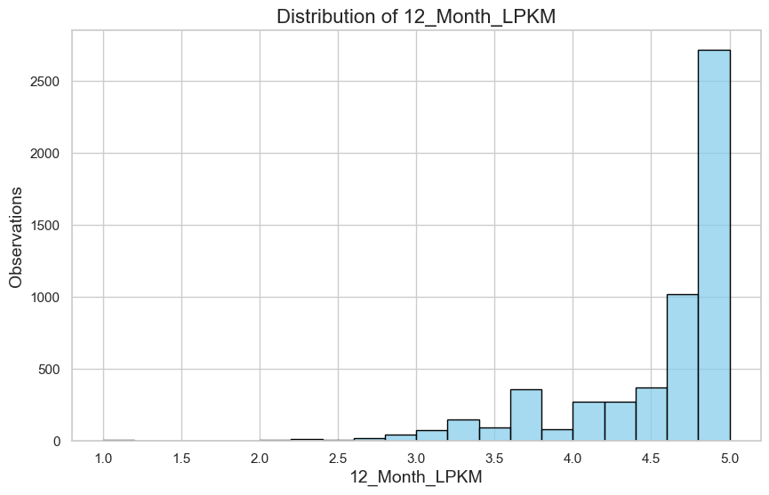
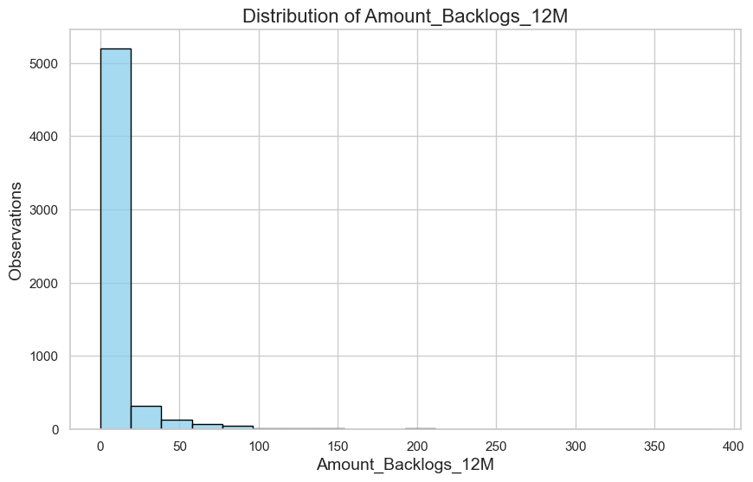
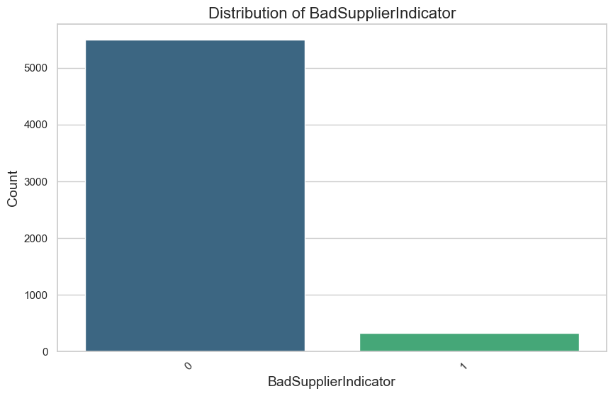
Data Exploration
Supplier Performance – Distributions
Wrong Deliveries (12M)
LPKM score
Backlogs (12M)
Bad Supplier Indicator

Slide 11
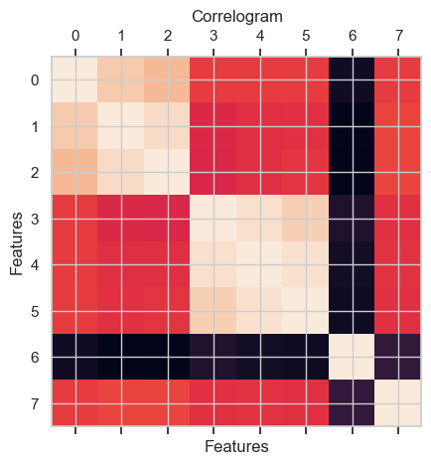
Data Exploration
Supplier Performance – Correlation
Positive correlation between 3, 6, and 12 months of wrong deliveries ~ 0.83
Positive correlation between 3, 6, and 12 months of backlogs ~ 0.94
Negative correlation between the LPKM score and all other features ~ 0.5

Slide 12
Data Exploration
Supplier Performance – Missing values

Slide 13
Data Preprocessing & Feature Engineering
Initial processes
Remove duplicate date features
Code categorical features numerically

Slide 14
Data Preprocessing & Feature Engineering
Initial processes
Remove duplicate date features
Code categorical features numerically

Slide 15
Data Preprocessing & Feature Engineering
Overall approach
Numerous suppliers without audit history or very few audit records
Varying number of entries

Slide 16
Model Selection & Predictions

Slide 17
Business Recommendations

Slide 18
Model Maintenance

Slide 19
Further Development

